Slide 1
Mongo GeoJSON

Slide 2
JSON FILE
From CSV to JSON

Slide 3
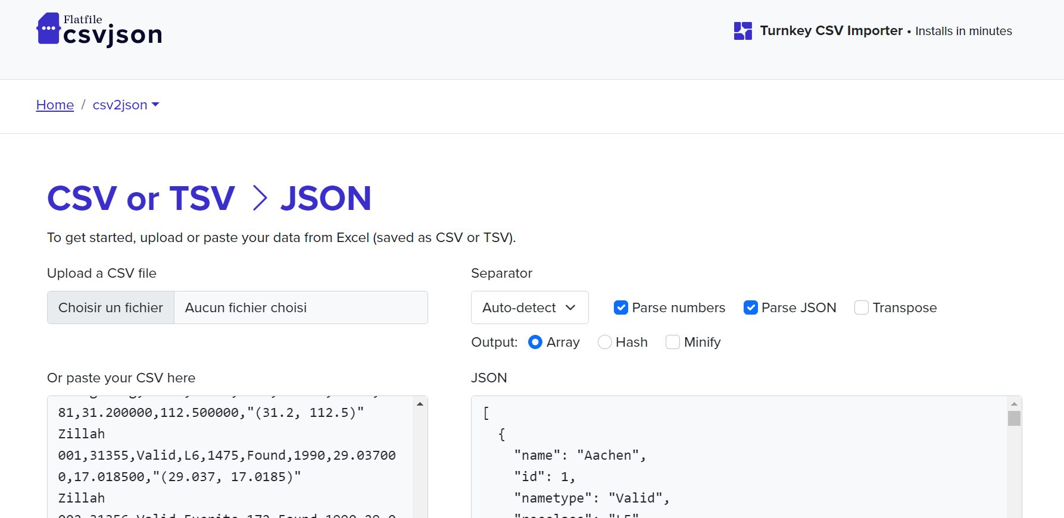

Slide 4
Mongo DB

Slide 5
QUERIES TO CLEAN THE DATABASE
{reclat: { $not: { $eq: "" } }, reclong: { $not: { $eq: "" } } }
Taking out the blank cells on latitude (reclat) and longitude (reclong)
Reduced the number of observations from 45716 to 38401:
nametype: « Valid »
Retaining only the « valid » meteorite claims
Reduced the number of observations from 38401 to 38331
Keeping fields id, name, year, reclat(latitude) and reclong(longitude)

Slide 6
SCREENSHOTS FROM MONGO DB

Slide 7
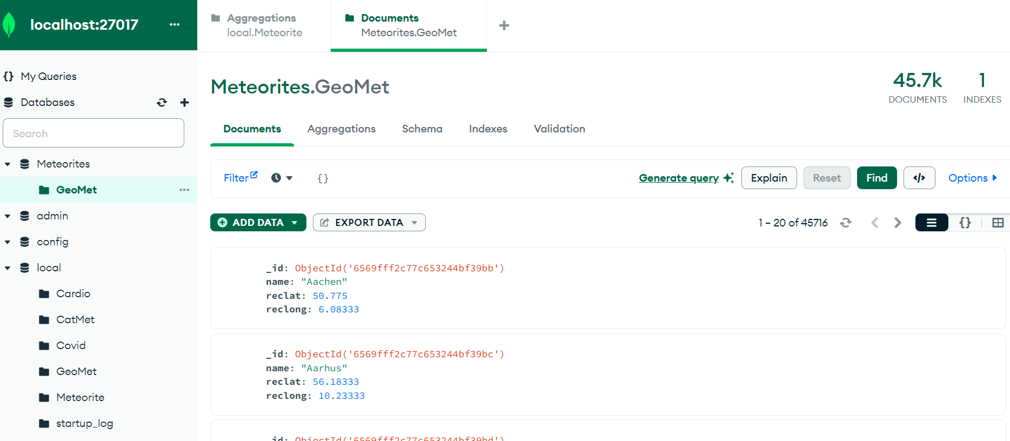
Starting with 45K OBSERVATIONS

Slide 8
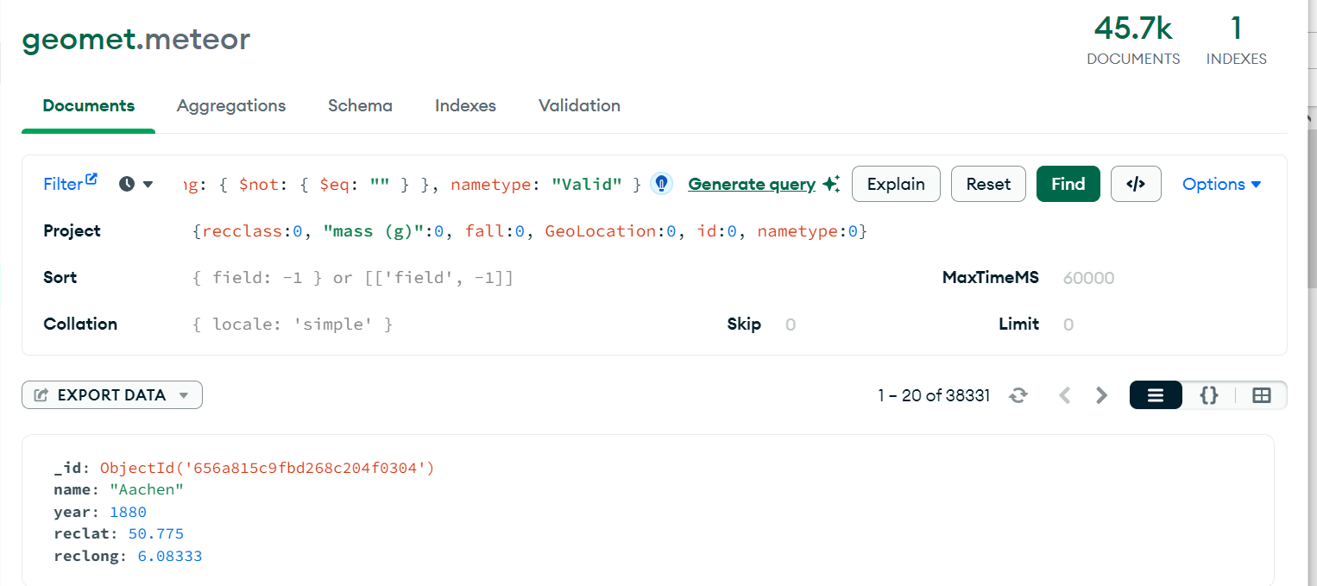
TAKING OUT NULL / SELECTING FIELDS

Slide 9
Python code to transform JSON into GEOJSON

Slide 10
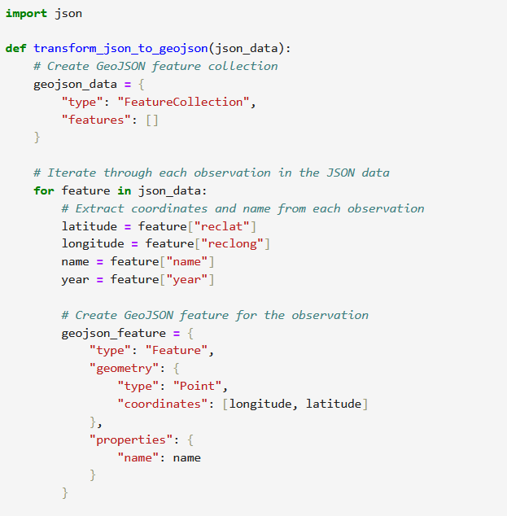
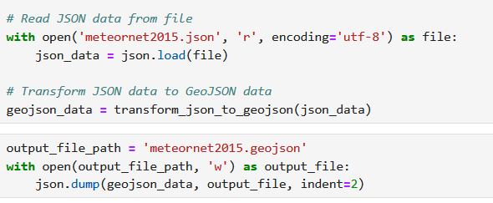
Python code to get GeoJSON data

Slide 11
From GeoJSON to maps with MAPBOX

Slide 12
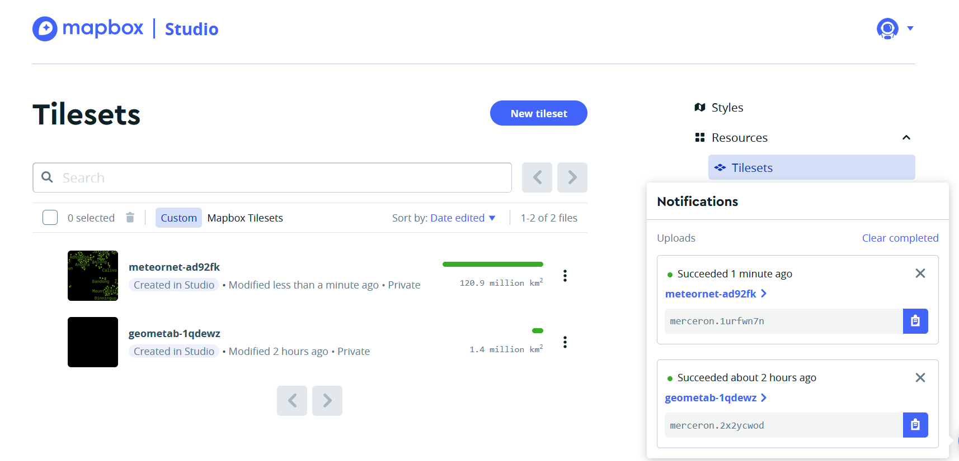

Slide 13
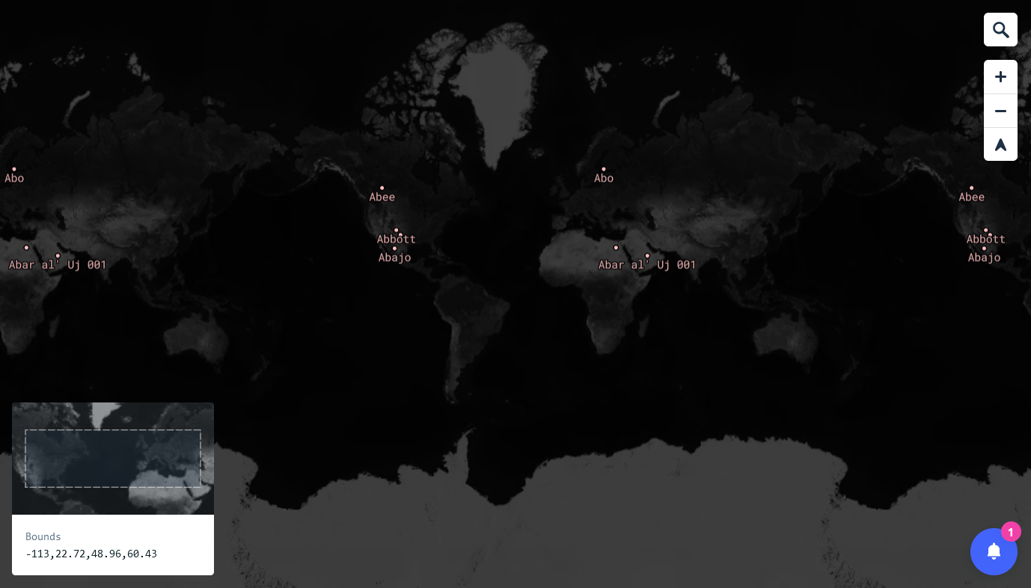
Intial test with a limited query (« ab* » names

Slide 14
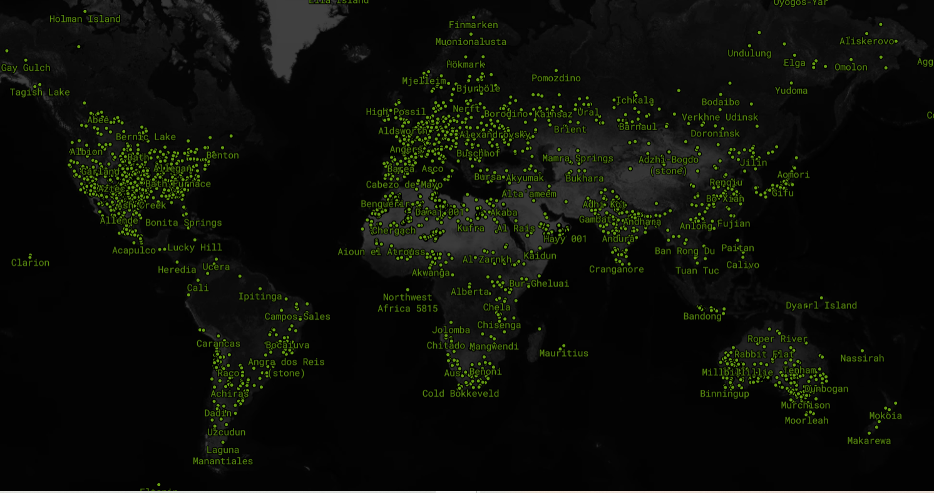

Slide 15
Selecting different timeframes on Mongo DB

Slide 16
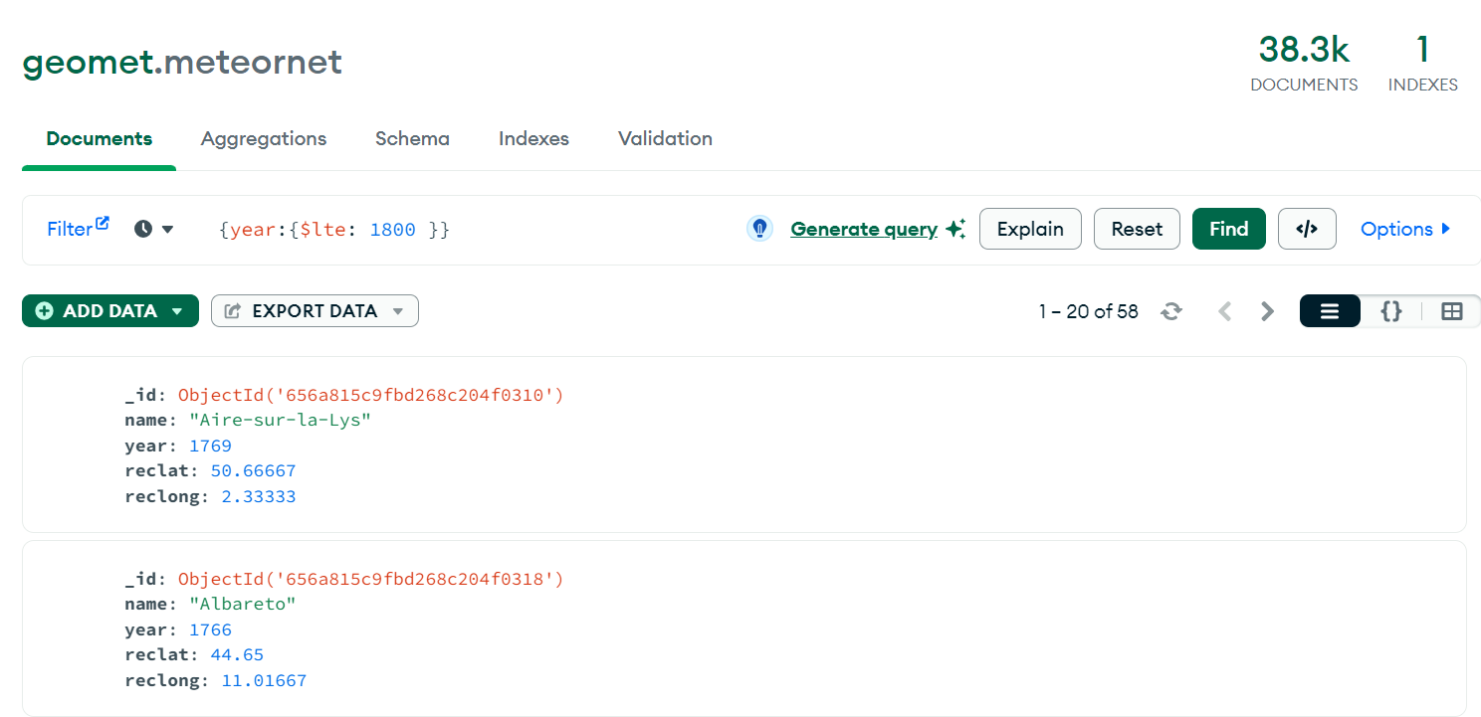

Slide 17


Slide 18
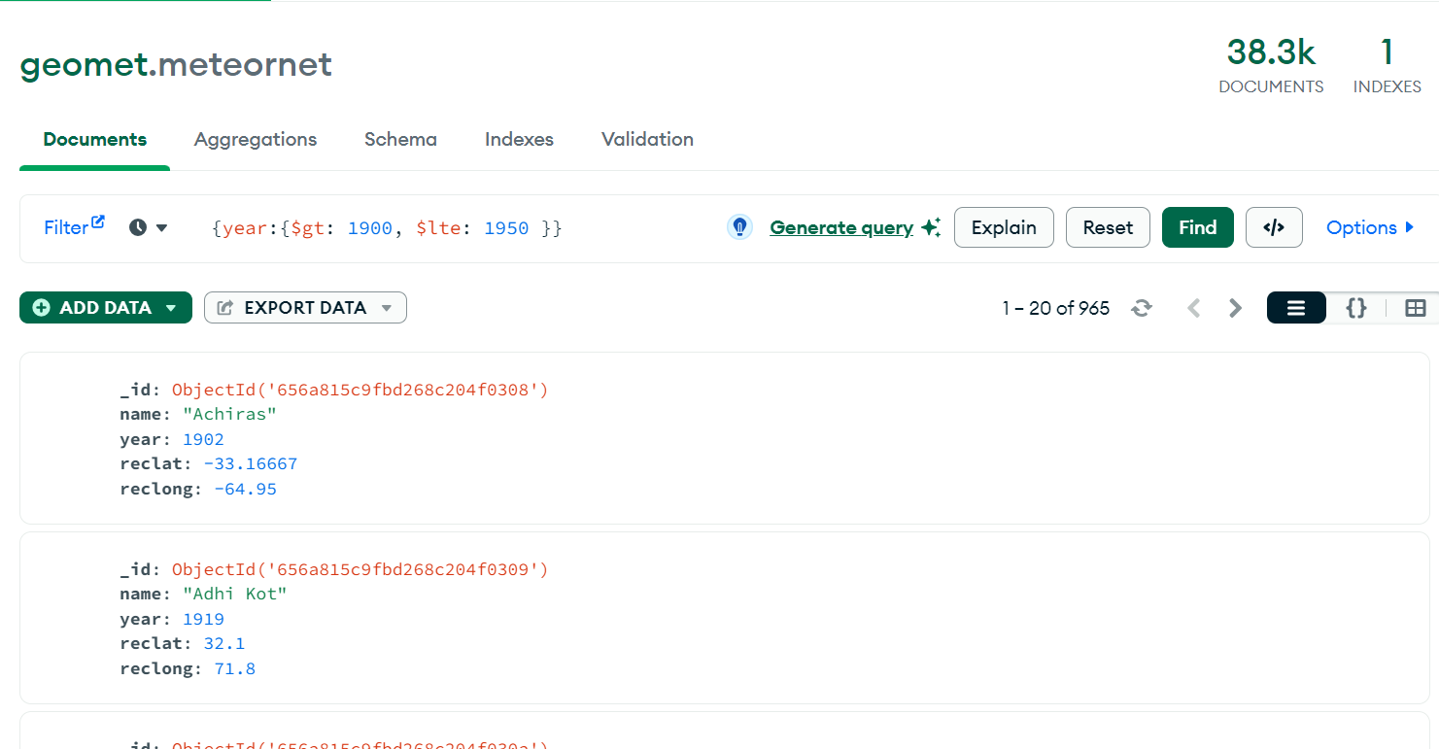

Slide 19
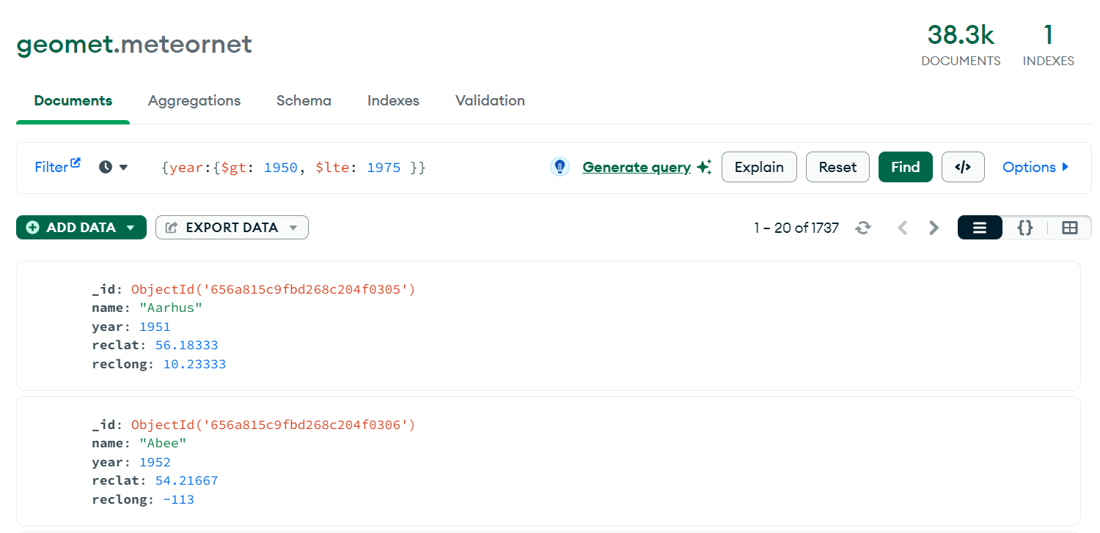

Slide 20
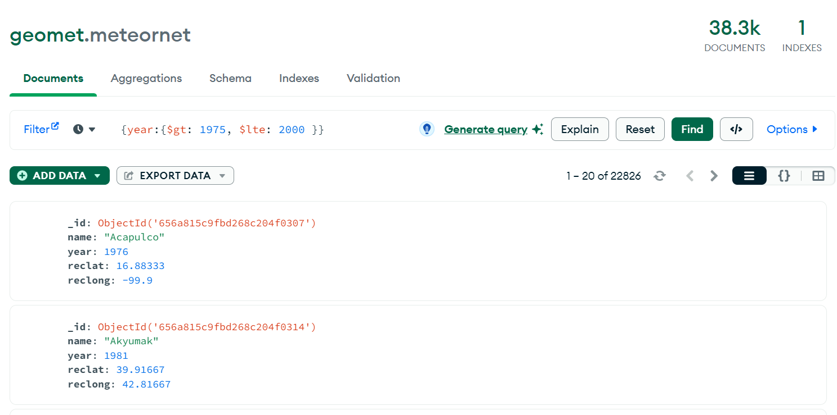

Slide 21
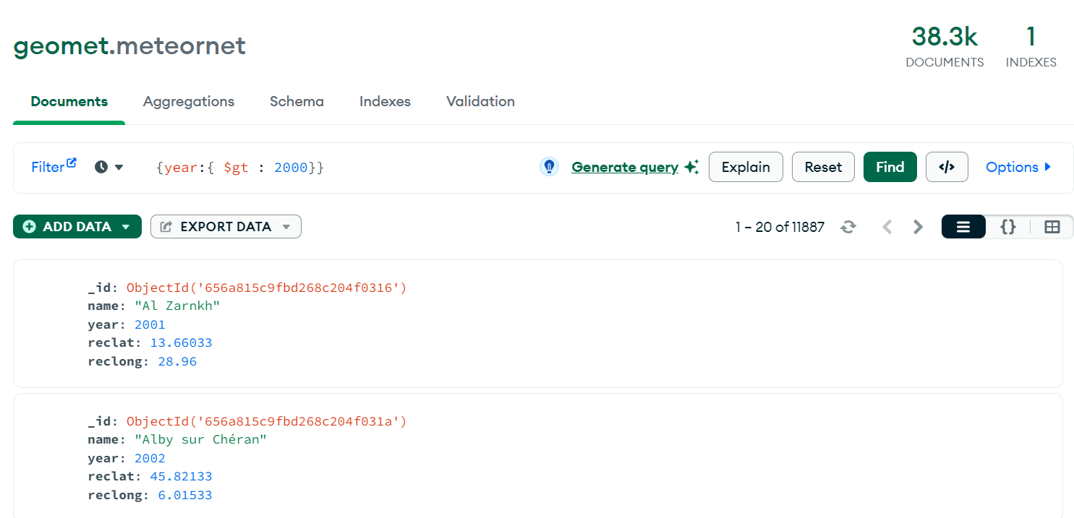

Slide 22
To produce progressive maps by time frame

Slide 23
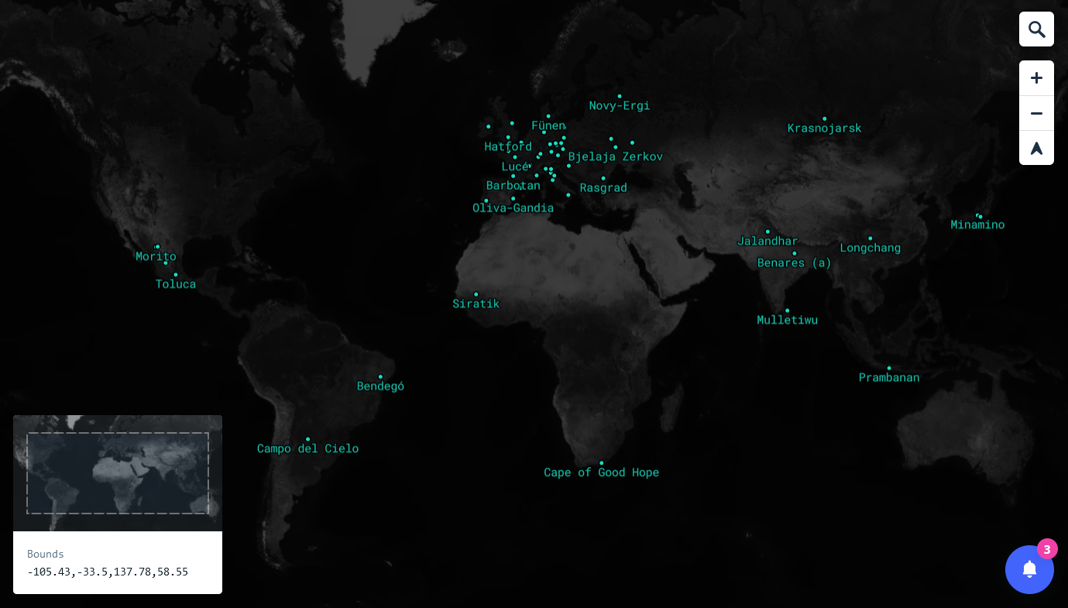
->1800
-> 1800

Slide 24
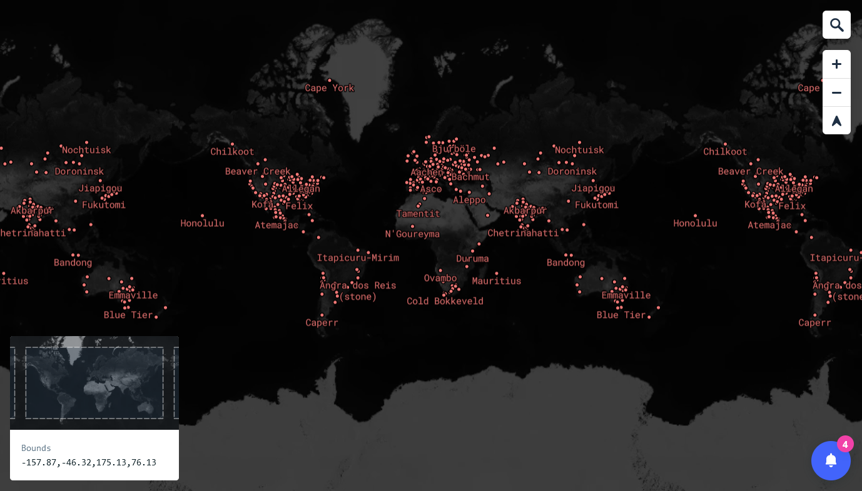
1800 - 1900
1800 - 1900

Slide 25
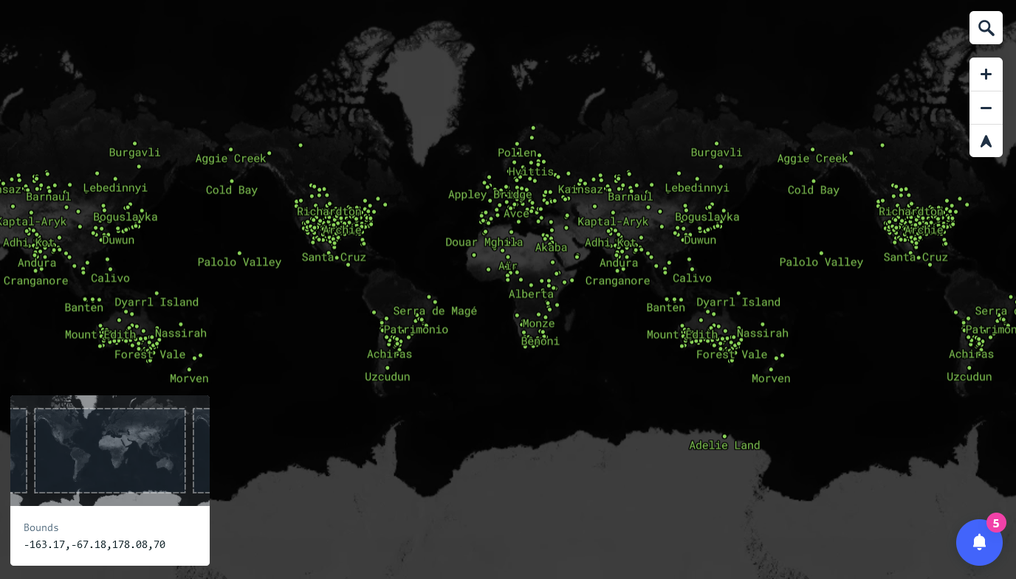
1900 - 1950
1900 - 1950

Slide 26
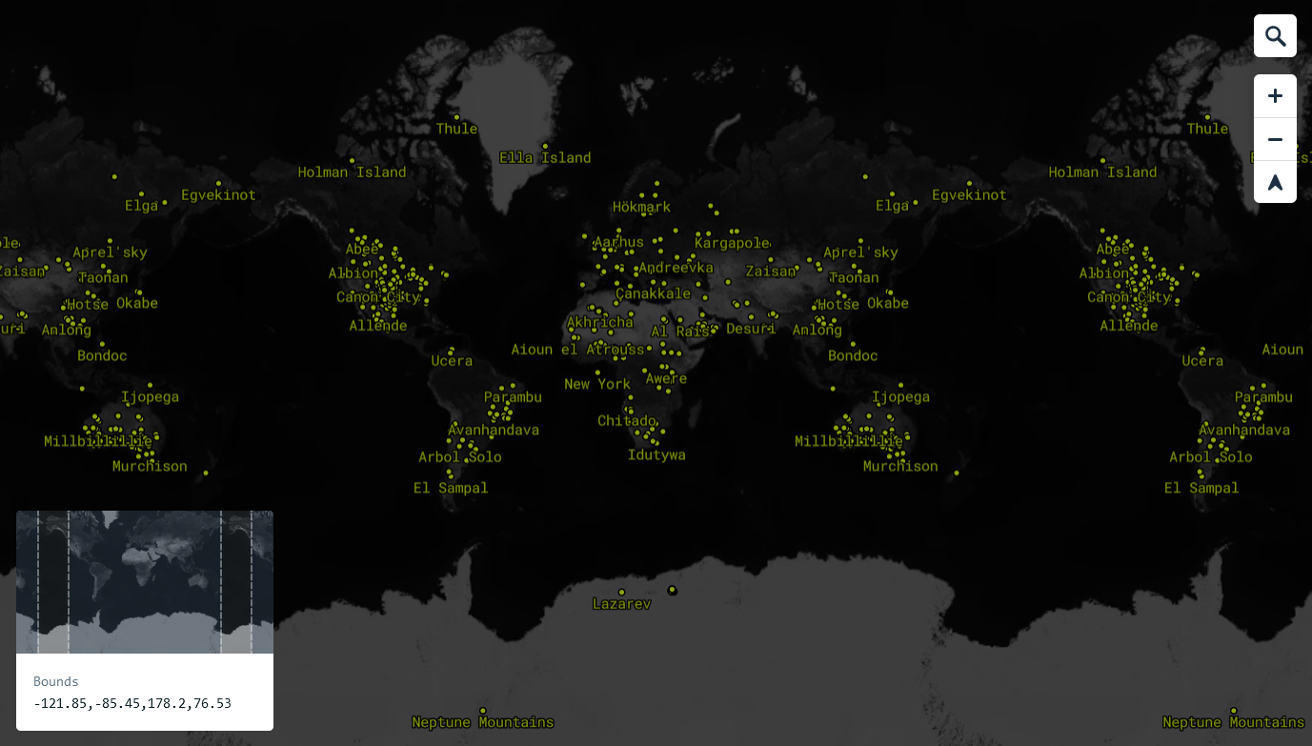
1950 - 1975

Slide 27
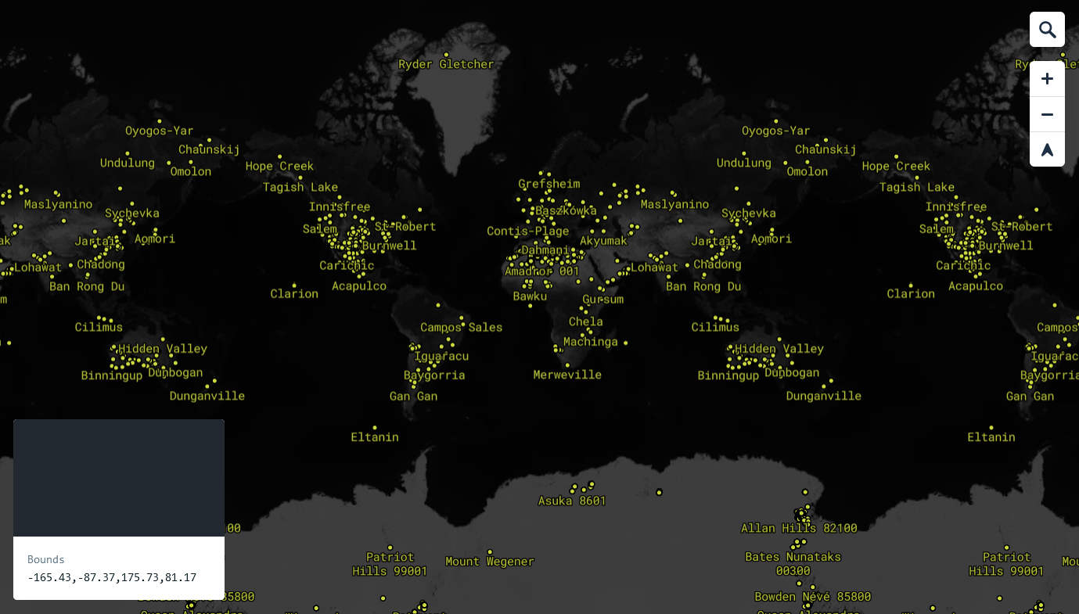
1950 - 1975
1975 - 2000

Slide 28
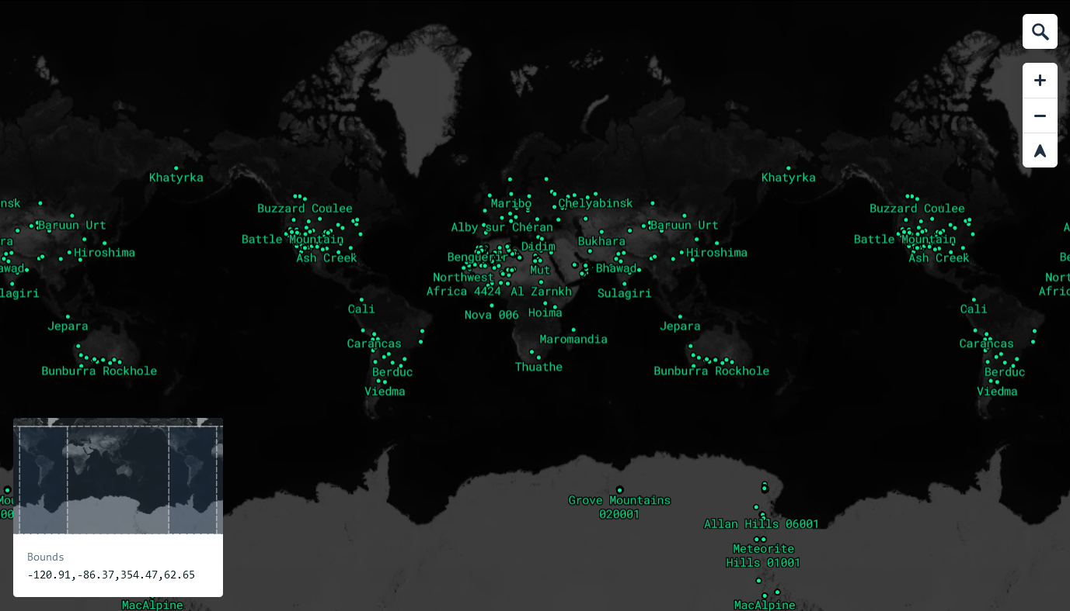
2000 - 2015

Slide 29
Final mapping visualization with rotating globe

Slide 30
See video

